Slide 1
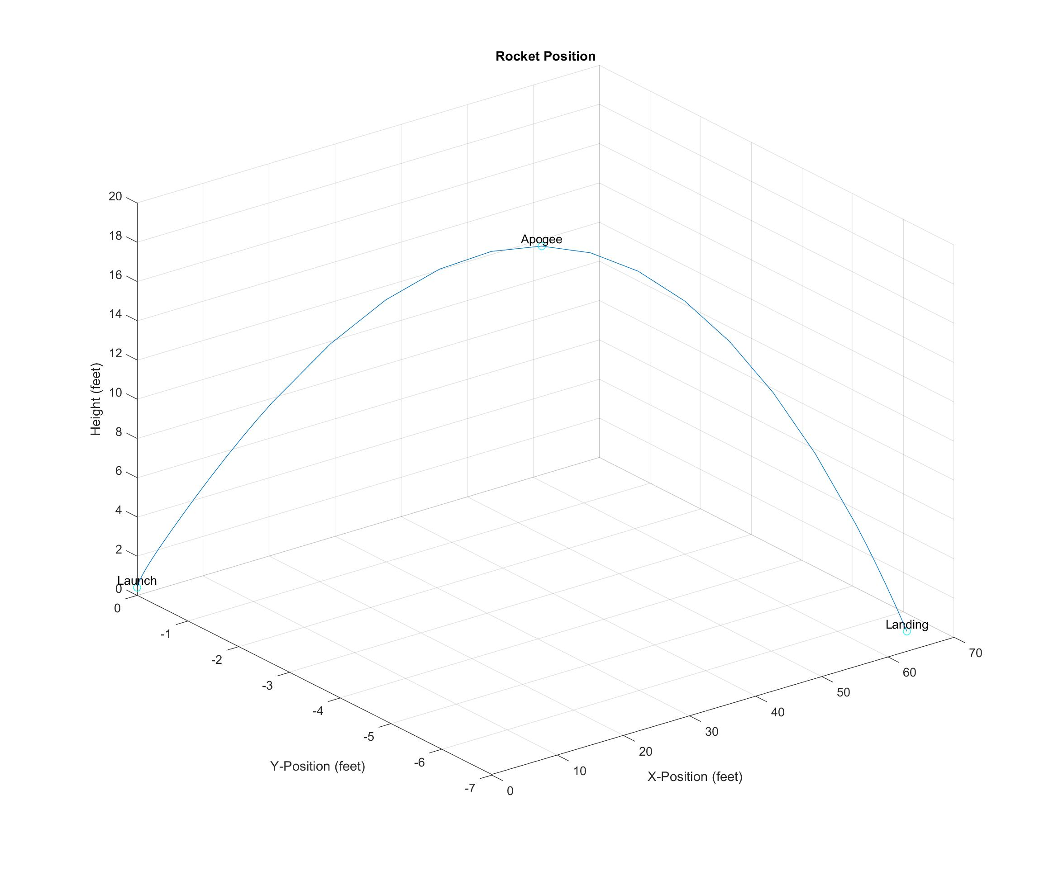
Rocket Phases
Water Expulsion
Water Expelled, air pressure dropping to ambient pressure
3. Ballistic Phase

